Slide 1
NEW DESIGNER PROGRAM Buyer Personas
September 2016

Slide 2
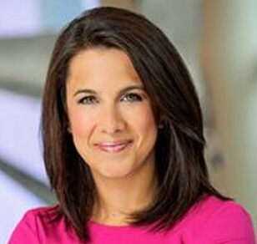
New Designer Program
NDP Persona #1
BACKGROUND:
Former VP of AT&T – worked both in Marketing and Customer Relations
MBA from UCLA
DEMOGRAPHICS:
Female
Age 35 – 45 (42)
Single – former income $185,000
Urban – lives in Tribeca
IDENTIFIERS:
Type A personality, used to going after something and making it happen
Detailed and organized
Expects a high level of response and professionalism from every course she takes or business interaction
Starting her biz based in love for her hobby. Making yoga apparel for women.

Slide 3
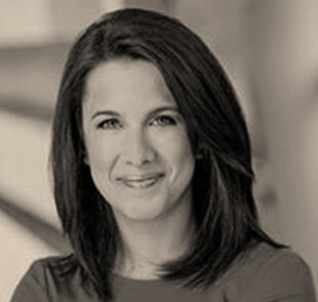
NDP #1 Julie
GOALS:
Launch first collection 12 months after starting the process
Pay all the bills ASAP and replace corporate salary in 3 years
CHALLENGES:
No background in fashion industry or manufacturing. Feels out of place, isolated.
Self funding, no team, very little support
HOW WE HELP:
NDP gives quick overview of Industry to make up for work experience
Trainings presented in non “fashion-y” way so Julie is not intimidated. Added bonus for Julie = Jane’s age level of “finishing school”

Slide 4
NDP #1 Julie
REAL QUOTES:
“I'm still struggling with this. Seems like there would be some kind of guideline out there.”
“The problem is that I can't figure out how she got .58 from 4 garments = 2 yards 8 inches. How do you convert it to decimal? I'm crap at math & can't get ahold of anyone at the pattern makers so hoping you guys might be able to help me! ”
“Thanks for this, Caryn! I just signed up for the same session so we can keep each other accountable :)”
COMMON OBJECTIONS:
Courses are all well and good but she probably wants on-going private coaching and support. One-off Sessions don’t cut it. Wants a mentor and hand-holding.

Slide 5
NDP #1 Julie
CIRCUMSTANCES
Successful in a different field but very uncertain of this new Industry. Feels out of her depth and insecure which is tough for her because she’s used to being smart at her job and accomplished.
MARKETING MESSAGING:
Crash Course for understanding the apparel industry when you come from a different field.
ELEVATOR PITCH:
Trainings at your convenience, at your level, so you can have a meeting and understand the “language” and culture of the Industry. NDP helps you NOT feel like a total newbie. We give you an honest look at the size and scope of the project you’re starting.

Slide 6
New Designer Program
NDP Persona #2 Alyssa
BACKGROUND:
Went to fashion school but doesn’t feel comfortable with the business side
Works F/T at the front desk of a Doctor’s office
1 child
DEMOGRAPHICS:
Female
Age 23 - 30
Single HH income $29,000
Suburban
IDENTIFIERS:
Accustomed to learning “everything” on Google for free.
Has a “passion for fashion”
Believes the hype, loves fashion shows

Slide 7
NDP #2 Alyssa
GOALS:
Launch first collection ASAP. Hs no realistic understanding of how long that will take
Keep day gob and do this on the side. Not “all-in”, more half pregnant way to start a biz.
CHALLENGES:
Understands basics of patternmaking and design, no understanding of how that’s different from actual production systems and scaling for a business
Very little money, cash flow only from “real job”.
HOW WE HELP:
NDP teaches what they didn’t learn in school re: business skills
Our trainings are realistic and that appeals to some. (We don’t offer “make your dream a reality” rhetoric and “fashion-y” pics which can hurt us with this persona.)

Slide 8
NDP #1 Alyssa
REAL QUOTES:
“I just know I’m gonna be successful I can feel it. I just gotta believe in myself.”
“It’s important for a woman to have 2 streams of income”
“There is so much I didn’t learn in school – I have no business sense.”
COMMON OBJECTIONS:
Price is high.
Where do I go for questions?
I can probably learn it for free if I just Google enough stuff and watch enough free videos.

Slide 9
NDP #1 Alyssa
CIRCUMSTANCES
Knows the basics of getting a product designed and made (at least one at a time). Feels confident in “pedigree” but no knowledge of mass production. No connections. Does not understand business yet and sometimes feels there’s an age bias against her / she’s not taken seriously.
MARKETING MESSAGING:
Everything about how the Industry REALLY works taught by someone who’s actually DONE IT for a living. Not just theory, real-life teaching.
ELEVATOR PITCH:
You love to design and we love business. We help you go from idea in your head to actual sales of a product, step-by-step.

